Slide 1
WHO Anthro Survey Analyser
Dr. Sudhir Verma
SR,CFM, AIIMS,Bhopal

Slide 2
Introduction
The Anthro Survey Analyser is an online tool developed by the Department of Nutrition for Health and Development WHO.
The analyses are based on the WHO Child Growth Standards.
This version of the tool provides results for the anthropometric indexes:
    Height-for-age,
    Weight-for-age,
    Weight-for-height,
    Body Mass-index-for-age.

Slide 3
Introduction…
Tool is designed to build country capacity on data analysis and reporting
It aims to enhance good practice in survey data collection, survey analysis, and reporting results.

Slide 4
Steps to analyze survey
Preparation of data set
Uploading the file
Variable mapping

Slide 5
Steps to analyze survey …
Preparation of data set
Uploading the file
Variable mapping
Apply filters
Results

Slide 6
Results
The WHO Anthro Software included results disaggregated by age, sex, type of residence, and sub-regions/districts.
Stratifications according to wealth quintiles, mother’s education,
Calculations of confidence intervals and standard errors.
Provides child malnutrition estimates for the cutoffs (e.g. stunting
( height-for-age below -2SD) or wasting weight-for-height below -2SD, and others).

Slide 7
Results….
In addition to the online graphics and tables.
The tool provides two report templates:
  Data quality assessment report template and
  Summary report template.

Slide 8
Outputs of Anthro Survey Analyser
A z-score file based on the WHO Child Growth Standards
A prevalence file based on the WHO recommended standard
All results are provided at overall and disaggregated levels
A data quality report template in Word format.
A survey report template in Word format.
Graphics and figures included in the application are in grayscale.

Slide 9
Data preparation
The data file to be imported should be in a comma delimited format (.csv).
The file can be created in any spreadsheet such as Microsoft Excel.
variable label can only contain
  characters,
  numbers,
  "_", and
  "-“.
It should not include spaces or symbols.

Slide 10
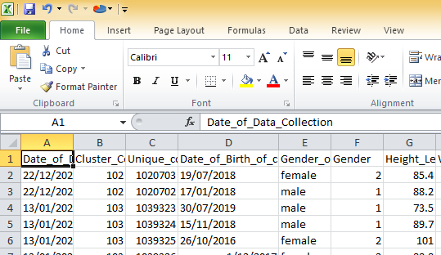
Data preparation ….

Slide 11
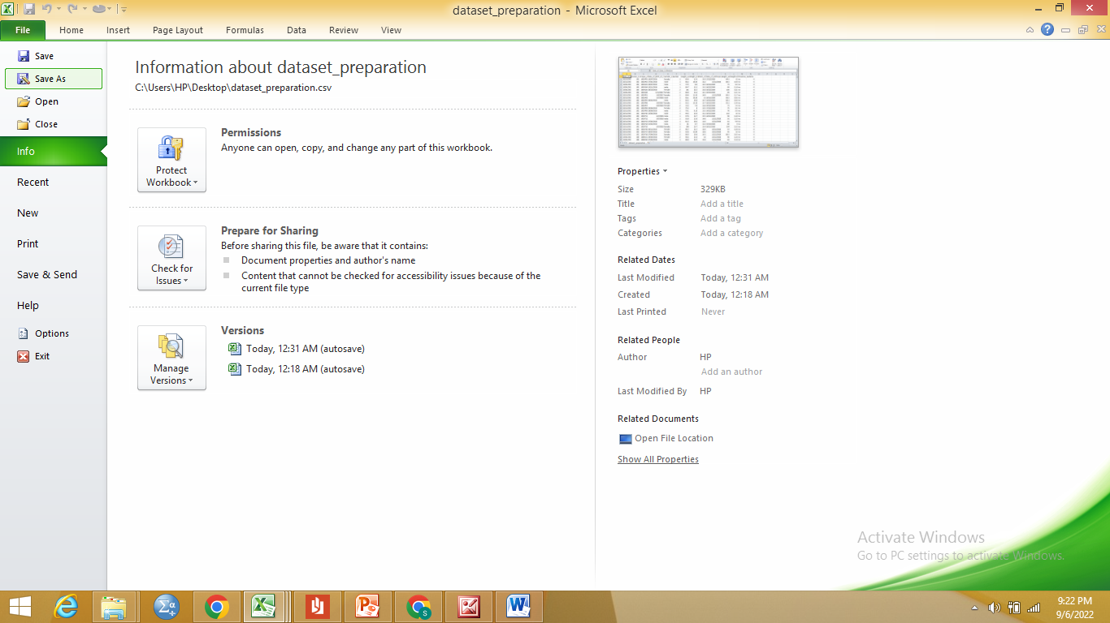
Data preparation …

Slide 12
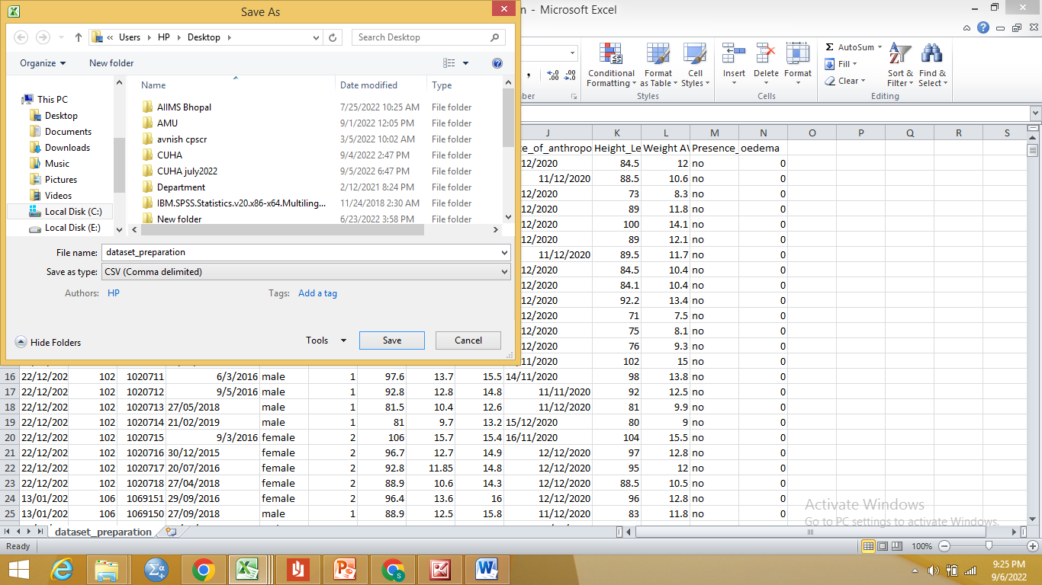
Data preparation …

Slide 13
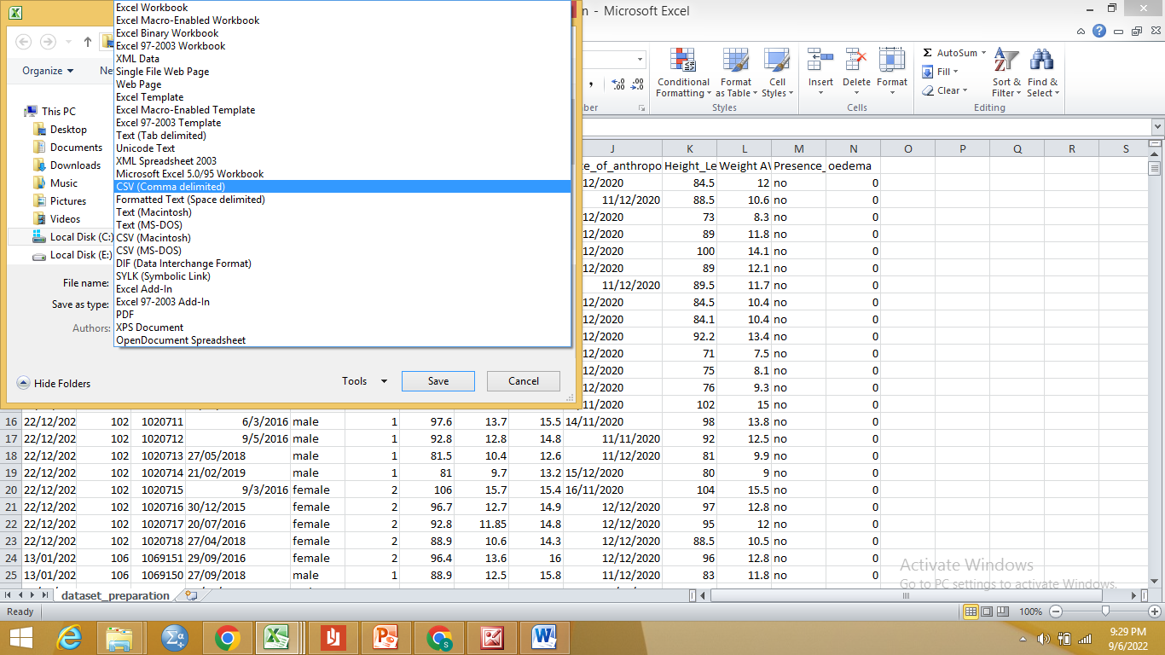
Data preparation …

Slide 14
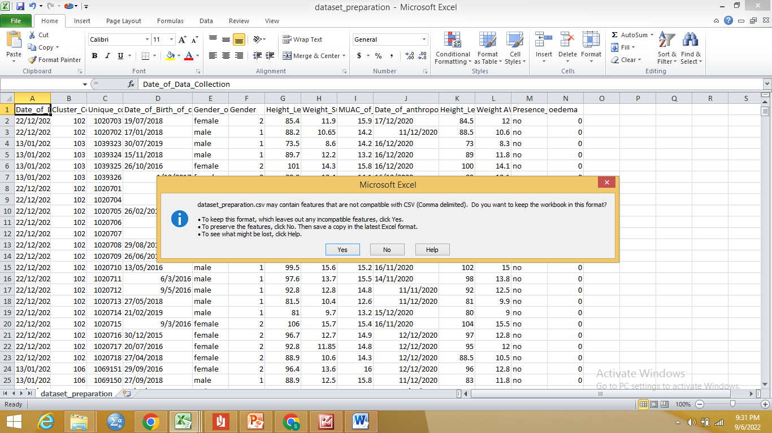
Data preparation ….

Slide 15
File Preparation….
1. Age related variables:
Compulsory Date of birth AND Date of visit: DD/MM/YYYY or MM/DD/YYYY.
2. Sex :
For male (1/”M”/”m”) and for female (2/”F”/”f”).
3. Weight:
Numeric, float value (in kilograms). Limited between 0.9-58.0kg.

Slide 16
File Preparation….
4.Length or height
Numeric (in centimetres). Limited between 38.0-150.0 cm.
5. Height or length measurement:
Recumbent length is used for children aged less than 731 days and standing height for those aged 731 or more days.
the tool automatically adjusts the length/height of each child when calculating z-scores by adding 0.7cm if standing height is measured for children aged < 24 months and subtracting 0.7cm if recumbent (lying) length is measured for children aged ≥24 months.

Slide 17
File Preparation….
6. Oedema :
Character. For no oedema (“N”, “n”, or “2”) and for oedema cases (“Y”, “y”, or “1”).
7. Residence Type :
Numeric Or Character. “Rural” or “Urban”.
8. Missing data:
values such as 9999,9998, etc.

Slide 18
Uploading the file
Enter the following URL in the browser of your preference (e.g. Google Chrome, Mozilla Firefox).
https://whonutrition.shinyapps.io/anthro

Slide 19
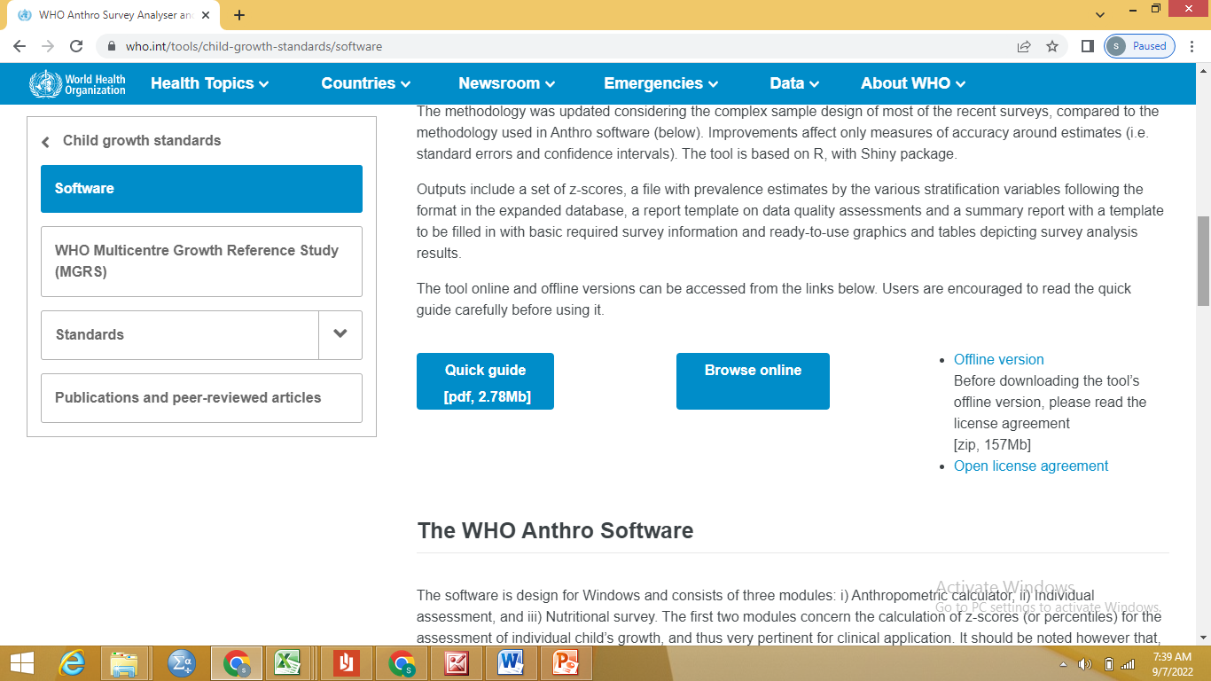
Uploading the file…..

Slide 20
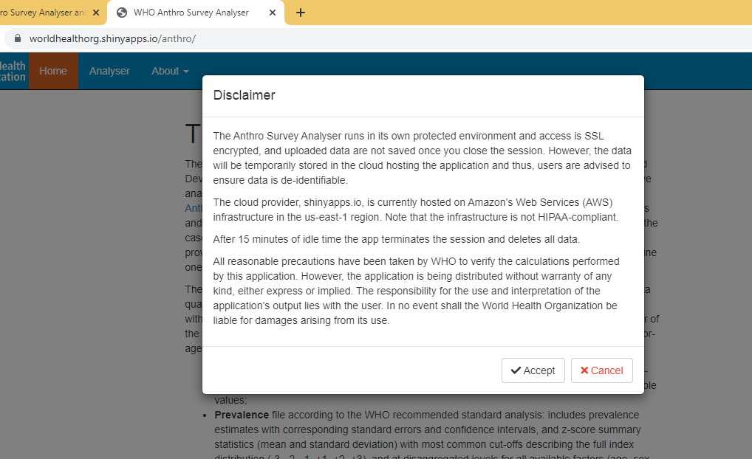
Uploading the file…..

Slide 21
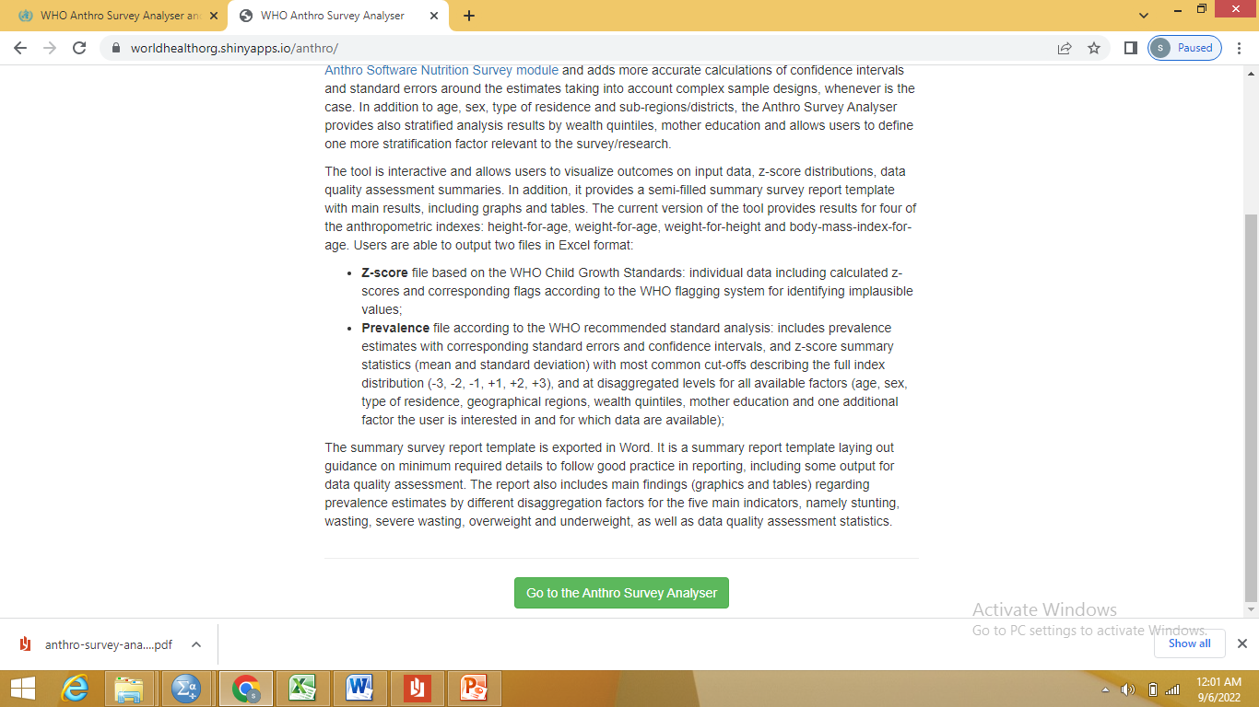
Uploading the file…..

Slide 22
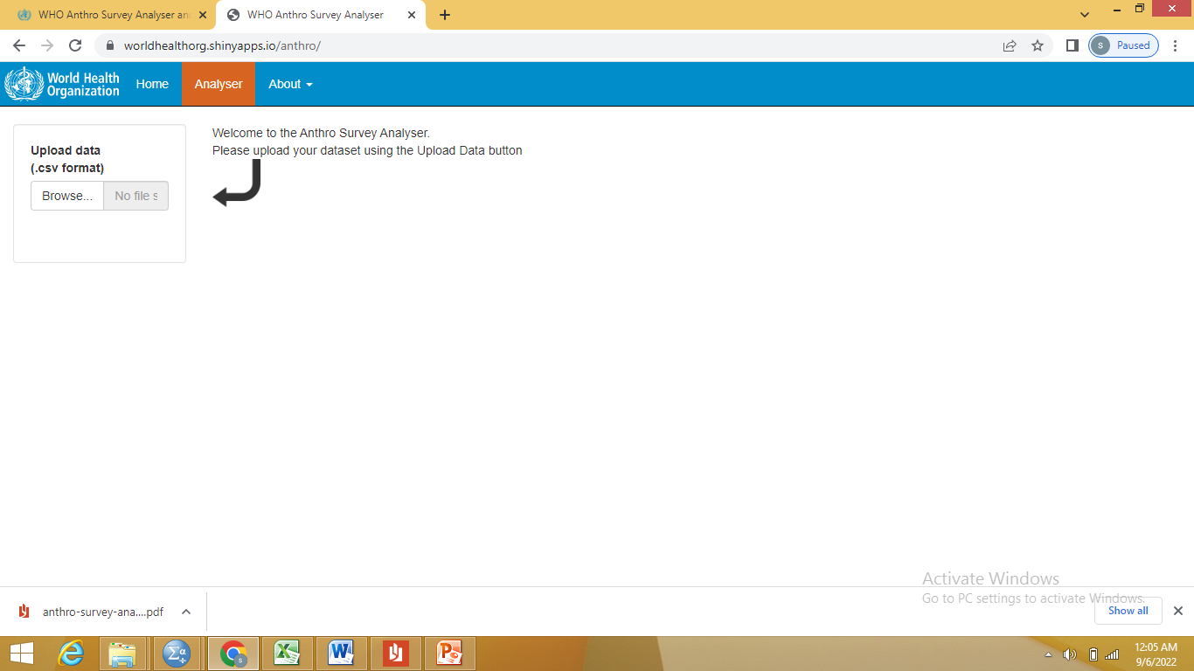
Uploading the file…..

Slide 23
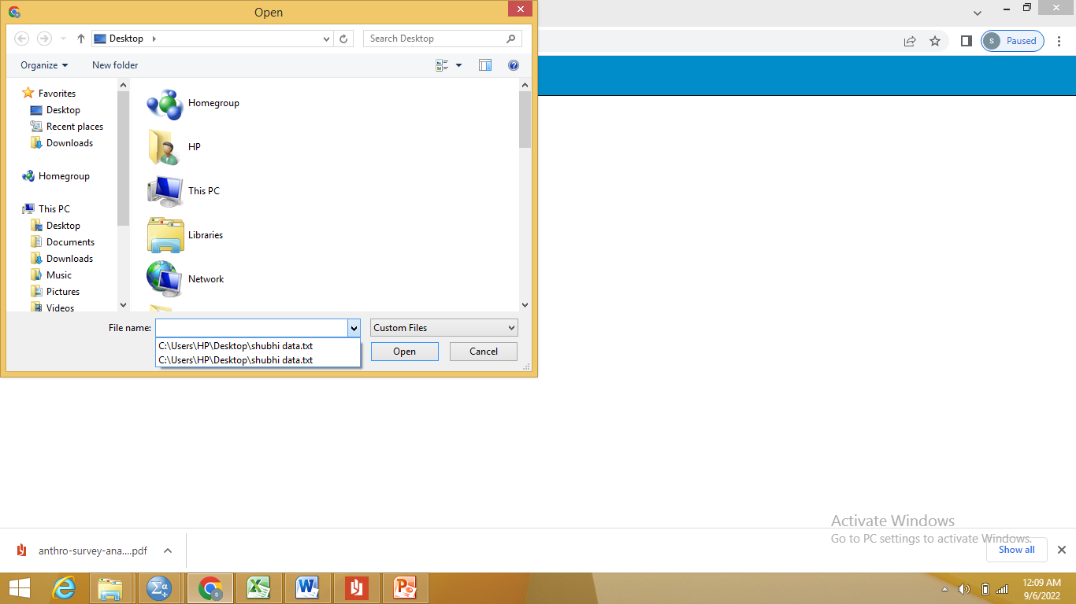
Uploading the file…..

Slide 24
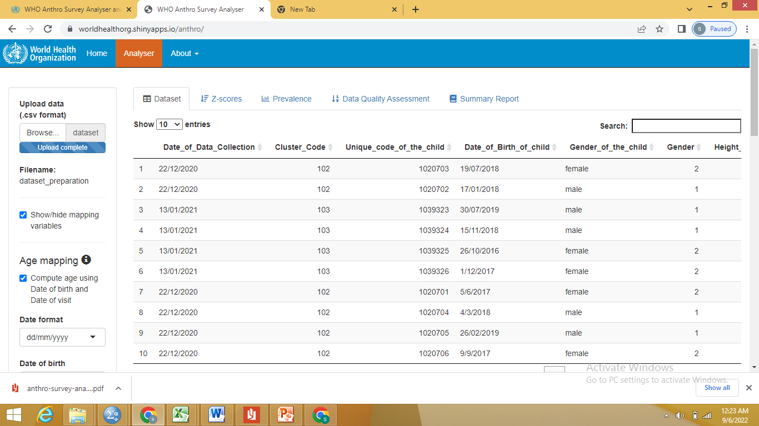
Uploading the file…..

Slide 25


