Slide 1

Computing anthropometric indicators for Under 5 children
Presentation by: Dr.G.Revadi, Senior Resident.

Slide 2
Learning objectives
Download and installation of the software
Requirements for analysis
Steps to analyse surveys
Online demonstration
Reading the downloaded output
Differences from the Anthro software
Hands On Practice

Slide 3
Download and Installation
WHO Anthro Survey Analyser
WHO Anthro

Slide 4
1a.WHO Anthro Survey Analyser
Download
Installation
Starting with the software

Slide 5
2. Requirements for analysis
The data file to be imported should be in comma delimited format(.csv)
The required data preparation should have been done.
Example of Dataset_1

Slide 6
3.Steps to analyse surveys
Upload the dataset
Variable mapping
Dataset display

Slide 7
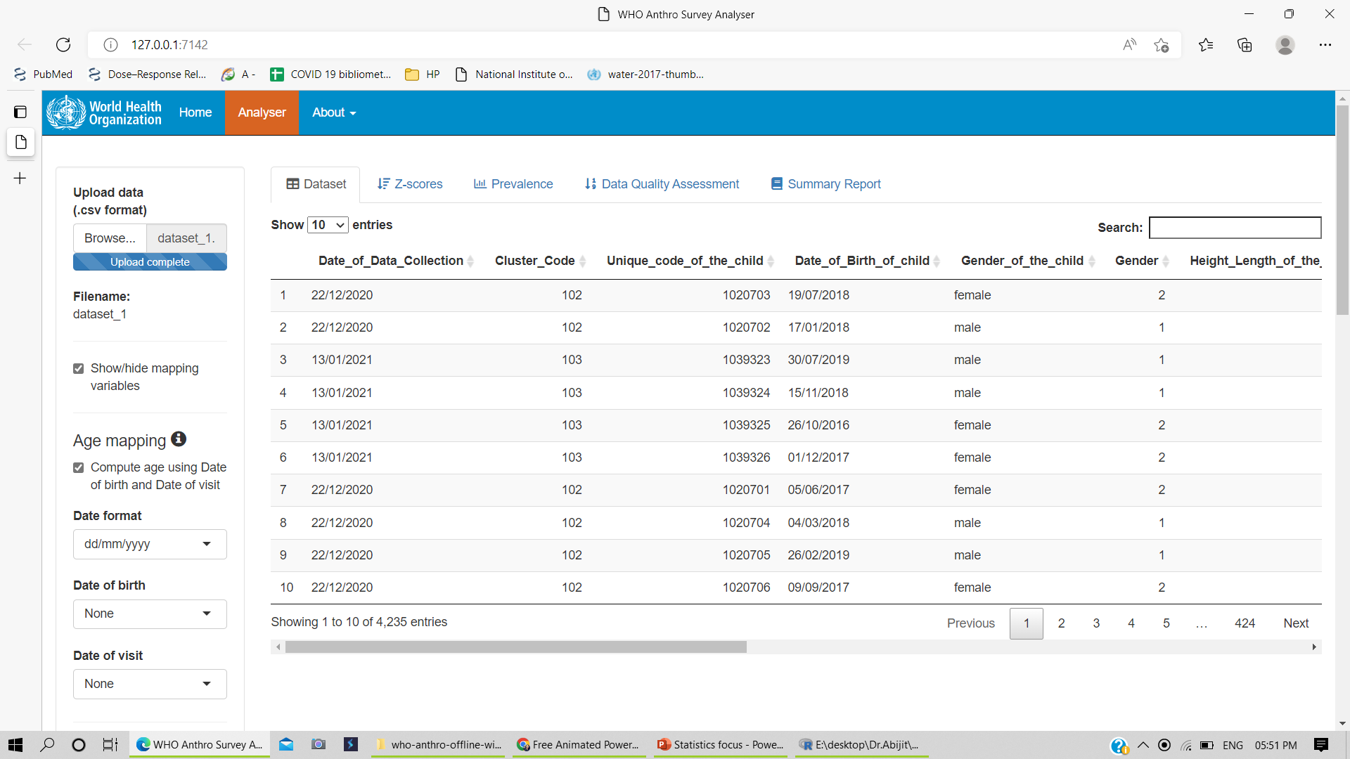
3a.Uploading the dataset

Slide 8
3.Steps to analyse surveys
Upload the dataset
Variable mapping
Dataset display

Slide 9
3b & c:
Variable mapping
On clicking the checkbox
Manually select the variables from the dataset and correspond to the variables in analysis

Slide 10
Mapping of the variables in dataset

Slide 11
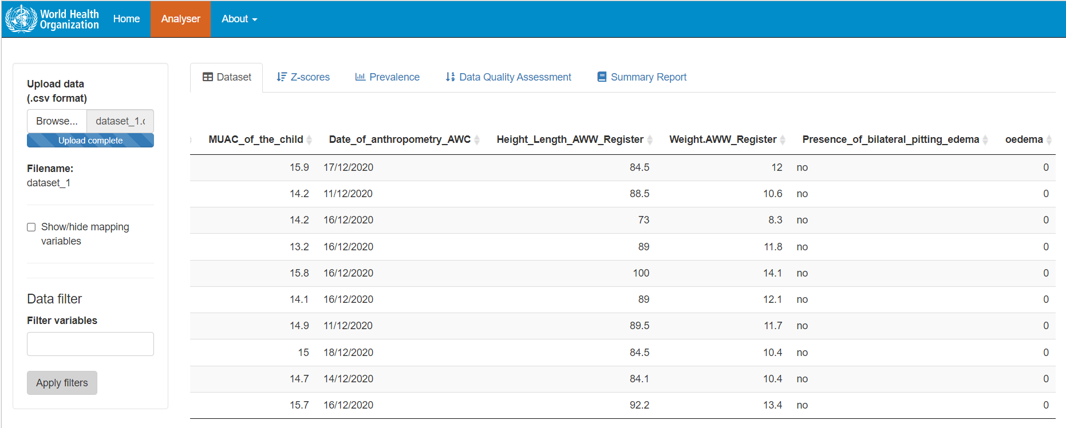
3b & c:
Variable mapping
Without clicking the checkbox

Slide 12
Age mapping

Slide 13
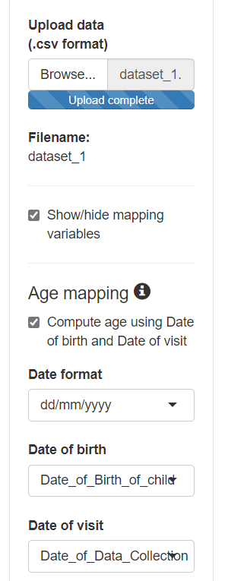
Age mapping
Variable in analysis
Variable in dataset
Refer to dataset_1 or dataset preparation
Default

Slide 14
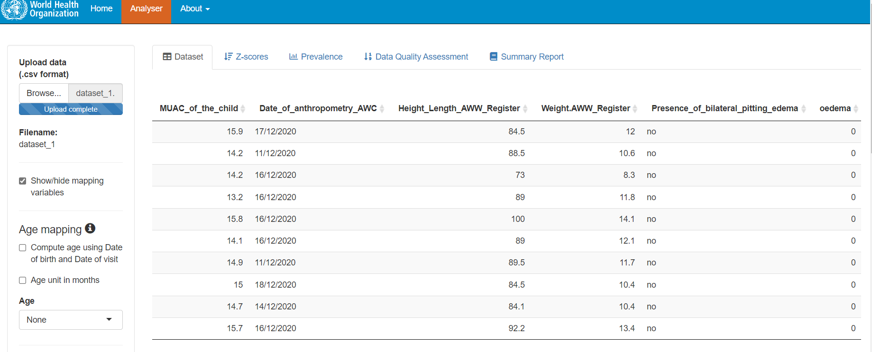
Prior to age mapping selection

Slide 15
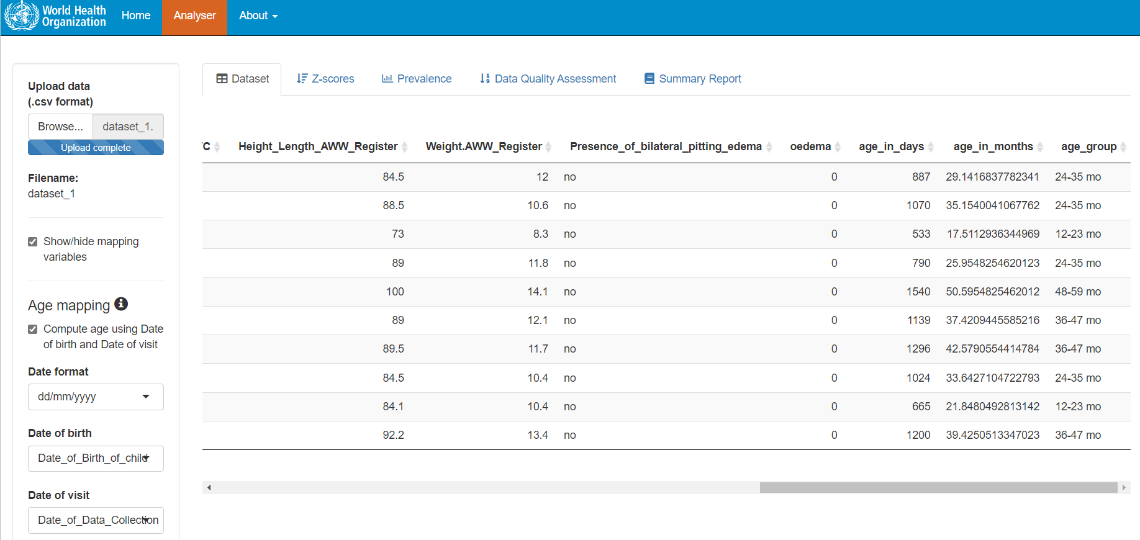
Addition of columns

Slide 16
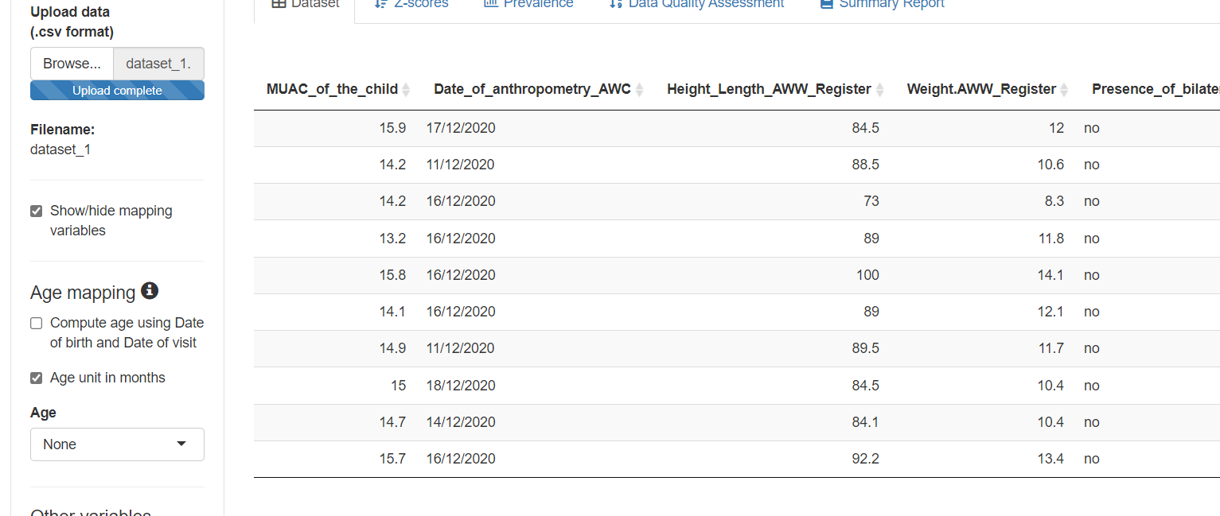
Age unit in months
Create a variable Age_months

Slide 17

6a. Online demonstration
Using WHO Anthro Survey Analyser software
Dataset_1

Slide 18

5.Output in Anthro Survey Analyser
Z score
Prevalence estimate

Slide 19
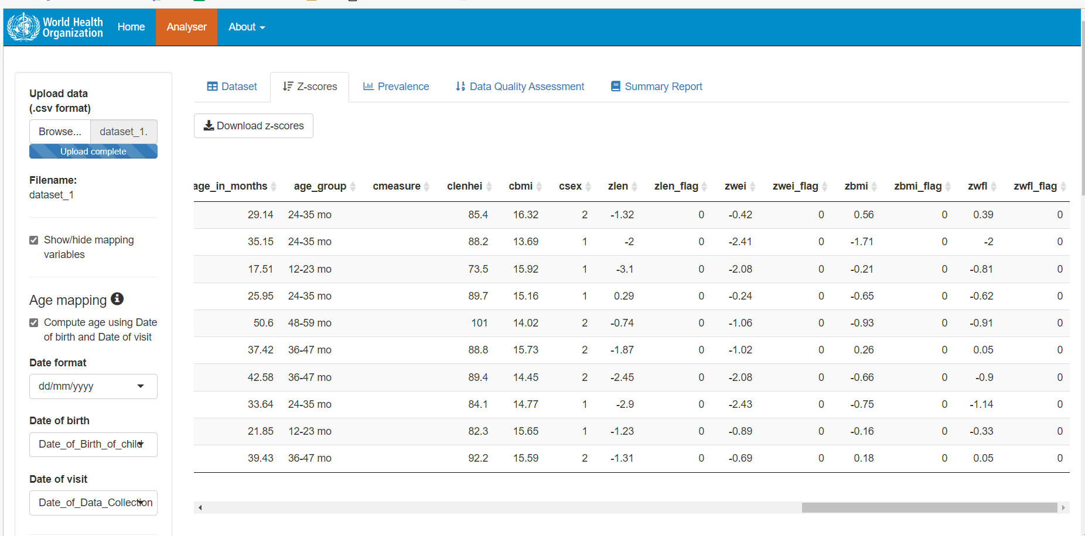
5a. Calculating Z score
Notes:
ERROR in download

Slide 20
5a.Understanding the results of Z score
Notes:
What does C stands for

Slide 21
Z score flags based on WHO flagging system

Slide 22
Common anthropometric indicators to assess nutrition status
Notes:
Overweight check for under 5 child, liberal for gain in weight

Slide 23
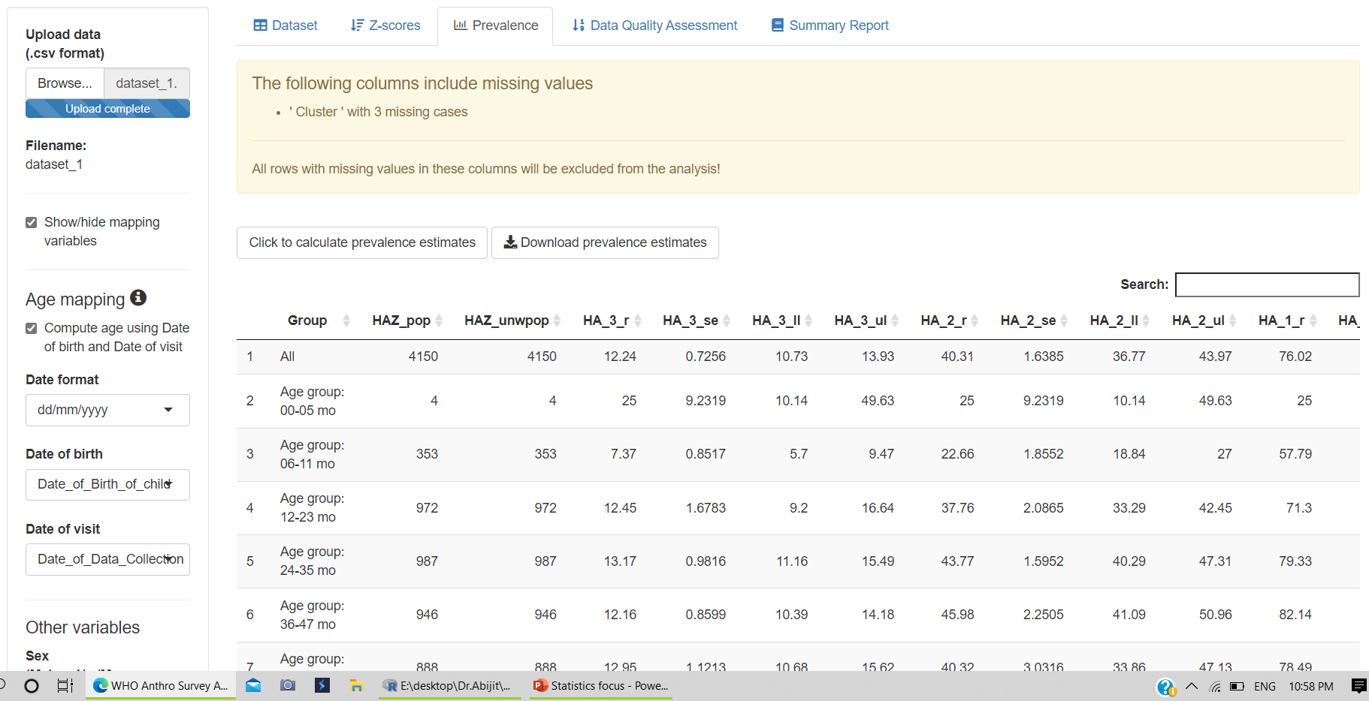
5b.Calculating the prevalence estimate

Slide 24
5b. Prevalence estimates Contd…….
Group | HAZ_pop | HAZ_unwpop | HA_3_r | HA_3_se | HA_3_ll
All | 4150 | 4150 | 12.24096 | 0.725647 | 10.73135
Age group: 00-05 mo | 4 | 4 | 25 | 9.231862 | 10.1351
Age group: 06-11 mo | 353 | 353 | 7.365439 | 0.851691 | 5.696818
Age group: 12-23 mo | 972 | 972 | 12.44856 | 1.678253 | 9.199316
Age group: 24-35 mo | 987 | 987 | 13.17123 | 0.981647 | 11.15678
Age group: 36-47 mo | 946 | 946 | 12.15645 | 0.859941 | 10.38704
Age group: 48-59 mo | 888 | 888 | 12.95045 | 1.121331 | 10.67598
Sex: Female | 2025 | 2025 | 11.55556 | 1.063137 | 9.413498
Sex: Male | 2125 | 2125 | 12.89412 | 0.629769 | 11.57031
Age + sex: 00-05 mo.Female | 3 | 3 | 33.33333 | 2.78E-15 | 33.33333
Age + sex: 06-11 mo.Female | 180 | 180 | 5 | 2.037527 | 2.006404
Age + sex: 12-23 mo.Female | 483 | 483 | 10.55901 | 1.516093 | 7.656699
Age + sex: 24-35 mo.Female | 488 | 488 | 12.29508 | 2.115796 | 8.342994
Age + sex: 36-47 mo.Female | 426 | 426 | 12.44131 | 2.137359 | 8.4468
Age + sex: 48-59 mo.Female | 445 | 445 | 13.48315 | 1.113264 | 11.21516
Age + sex: 00-05 mo.Male | 1 | 1 | 0 | 0 | 1.75E-09
Age + sex: 06-11 mo.Male | 173 | 173 | 9.82659 | 2.058812 | 6.133932
Age + sex: 12-23 mo.Male | 489 | 489 | 14.31493 | 2.366235 | 9.850241
Age + sex: 24-35 mo.Male | 499 | 499 | 14.02806 | 1.121571 | 11.73624
Age + sex: 36-47 mo.Male | 520 | 520 | 11.92308 | 1.188857 | 9.544396
Age + sex: 48-59 mo.Male | 443 | 443 | 12.41535 | 1.448314 | 9.562376
Notes:
Is r mean/prevalence here ?

Slide 25
5b.Understanding the results of prevalence estimates
Notes:
This is from nfhs 4, random subset, adjusted for sampling multiple stage, cluster, weight 1. inverse sampling probability of block, cluster, HH

Slide 26
Glimpses about WHO Anthro software

Slide 28
WHO Anthro Software
Input
Age
Oedema
Output
(WHO/NCHS)
Indicators for anthropometric parameters
Graphs for milestones
Anthropometric data
Gross Motor milestones (3-24 months)

Slide 29
Standards computed in Anthro Software
 | WHO Standards | NCHS Standards
L/H-for-age | Yes | Yes
W/A | Yes | Yes
BMI-for-age | Yes | NA
HC for age | Yes | NA
MUAC for age | Yes | NA
Triceps skinfold-for-age | Yes | NA
Subscapular skinfold for age | Yes | NA
Notes:
NCHS not applicable

Slide 30
Online demonstration
WHO Anthro software
Notes:
Nutritional survey, txt form

Slide 31

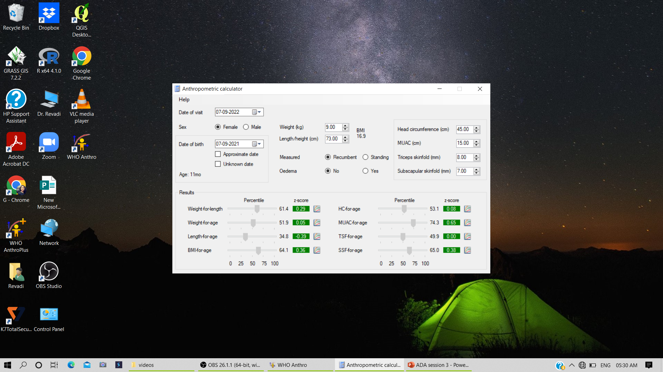
Get started with Anthro

Slide 33
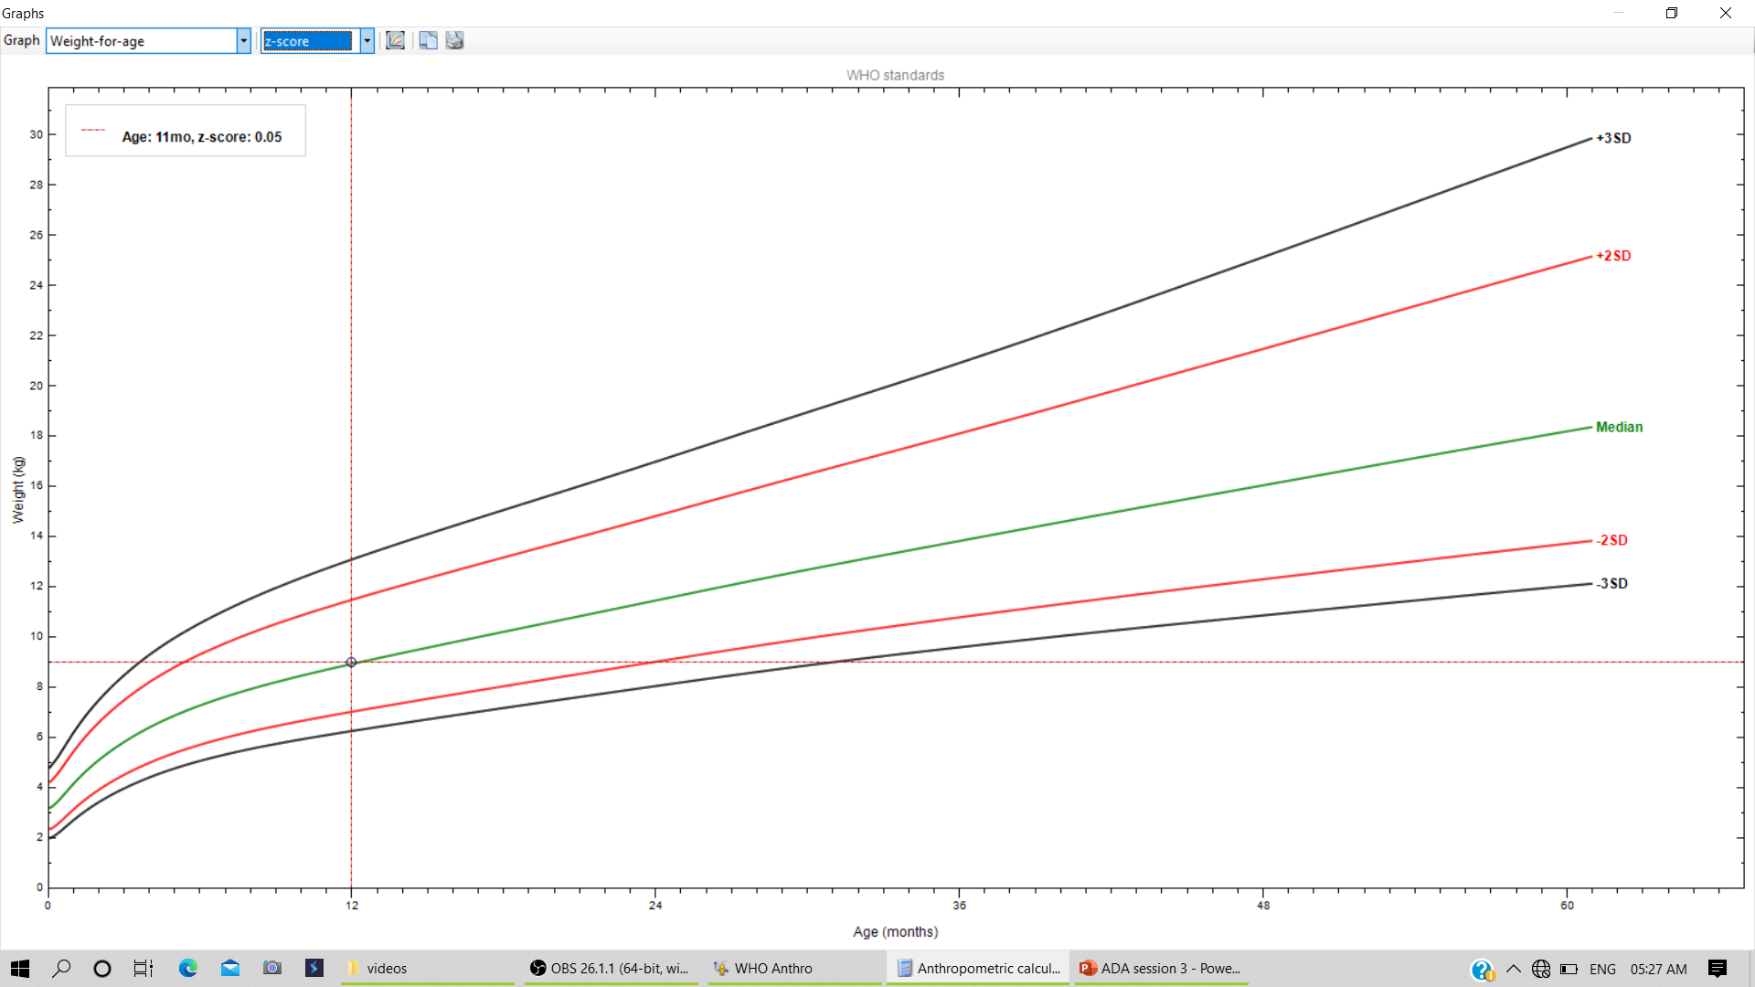

Slide 34
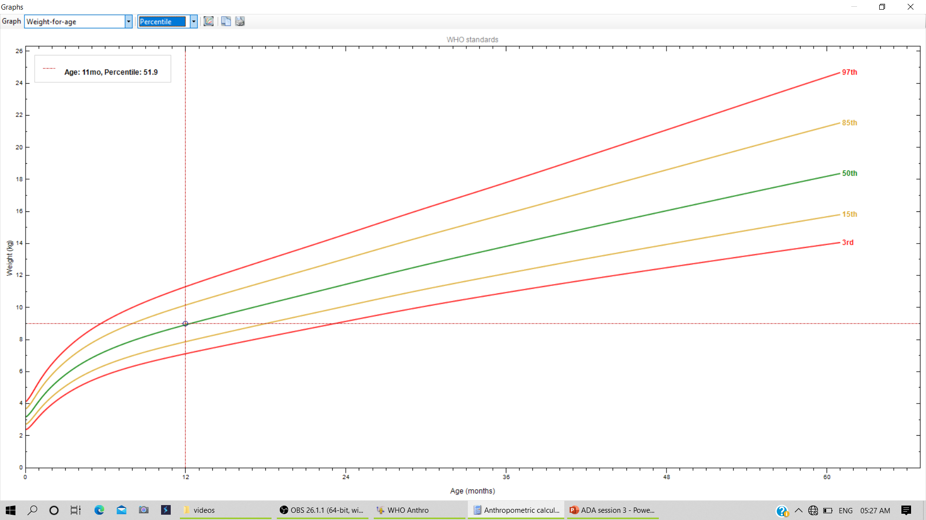

Slide 35
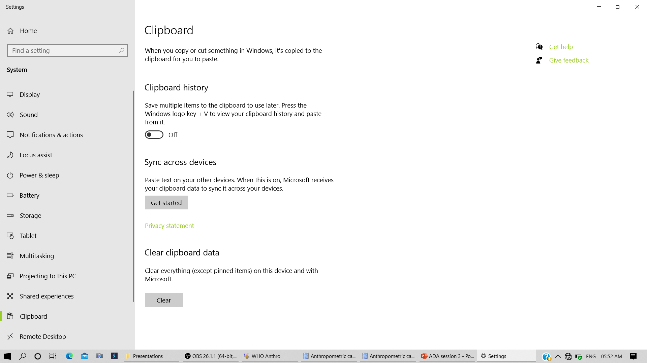
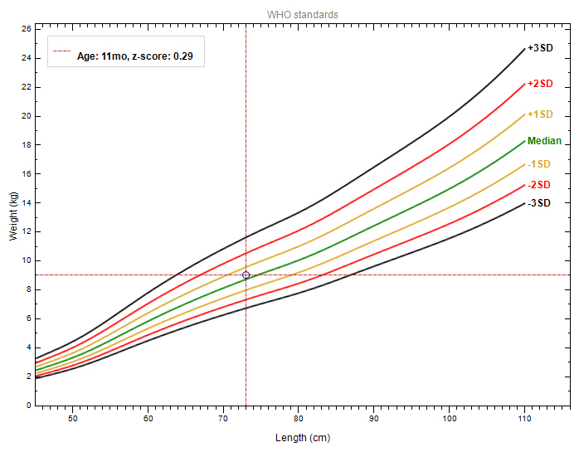
Exporting the graph from Anthro
Before Copy to clipboard – Clipboard settings turned on -
Copy to clipboard
Windows + V
Ctrl + C
Desired location – Ctrl +V

Slide 36
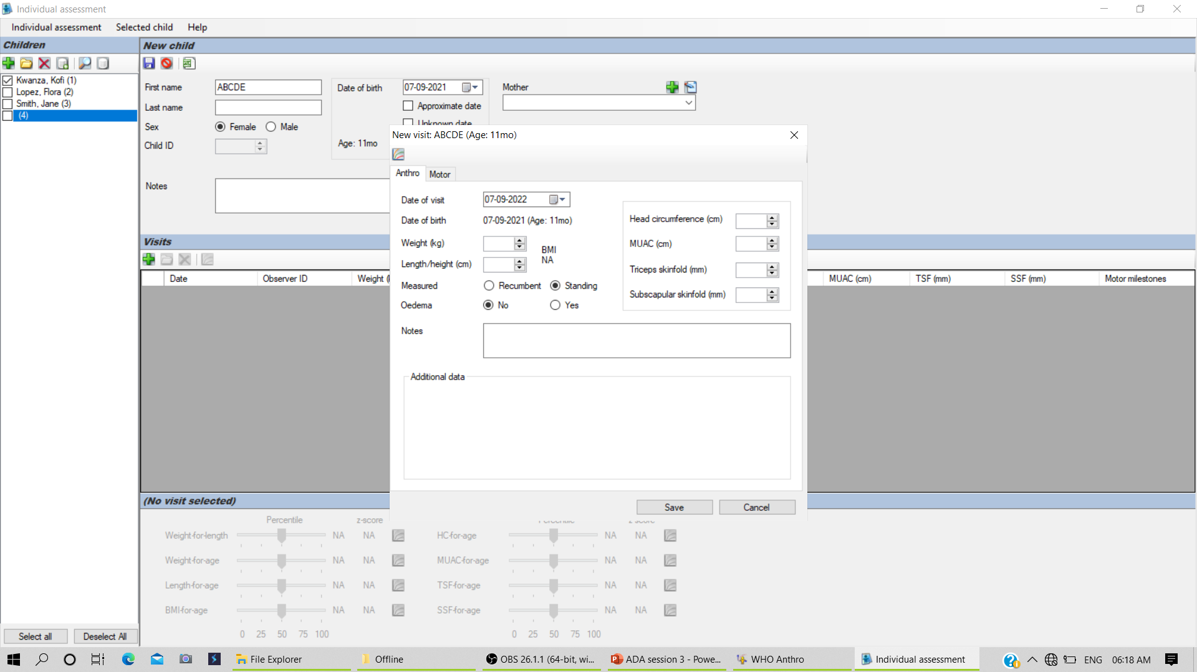
2.Individual assessment-

Slide 37
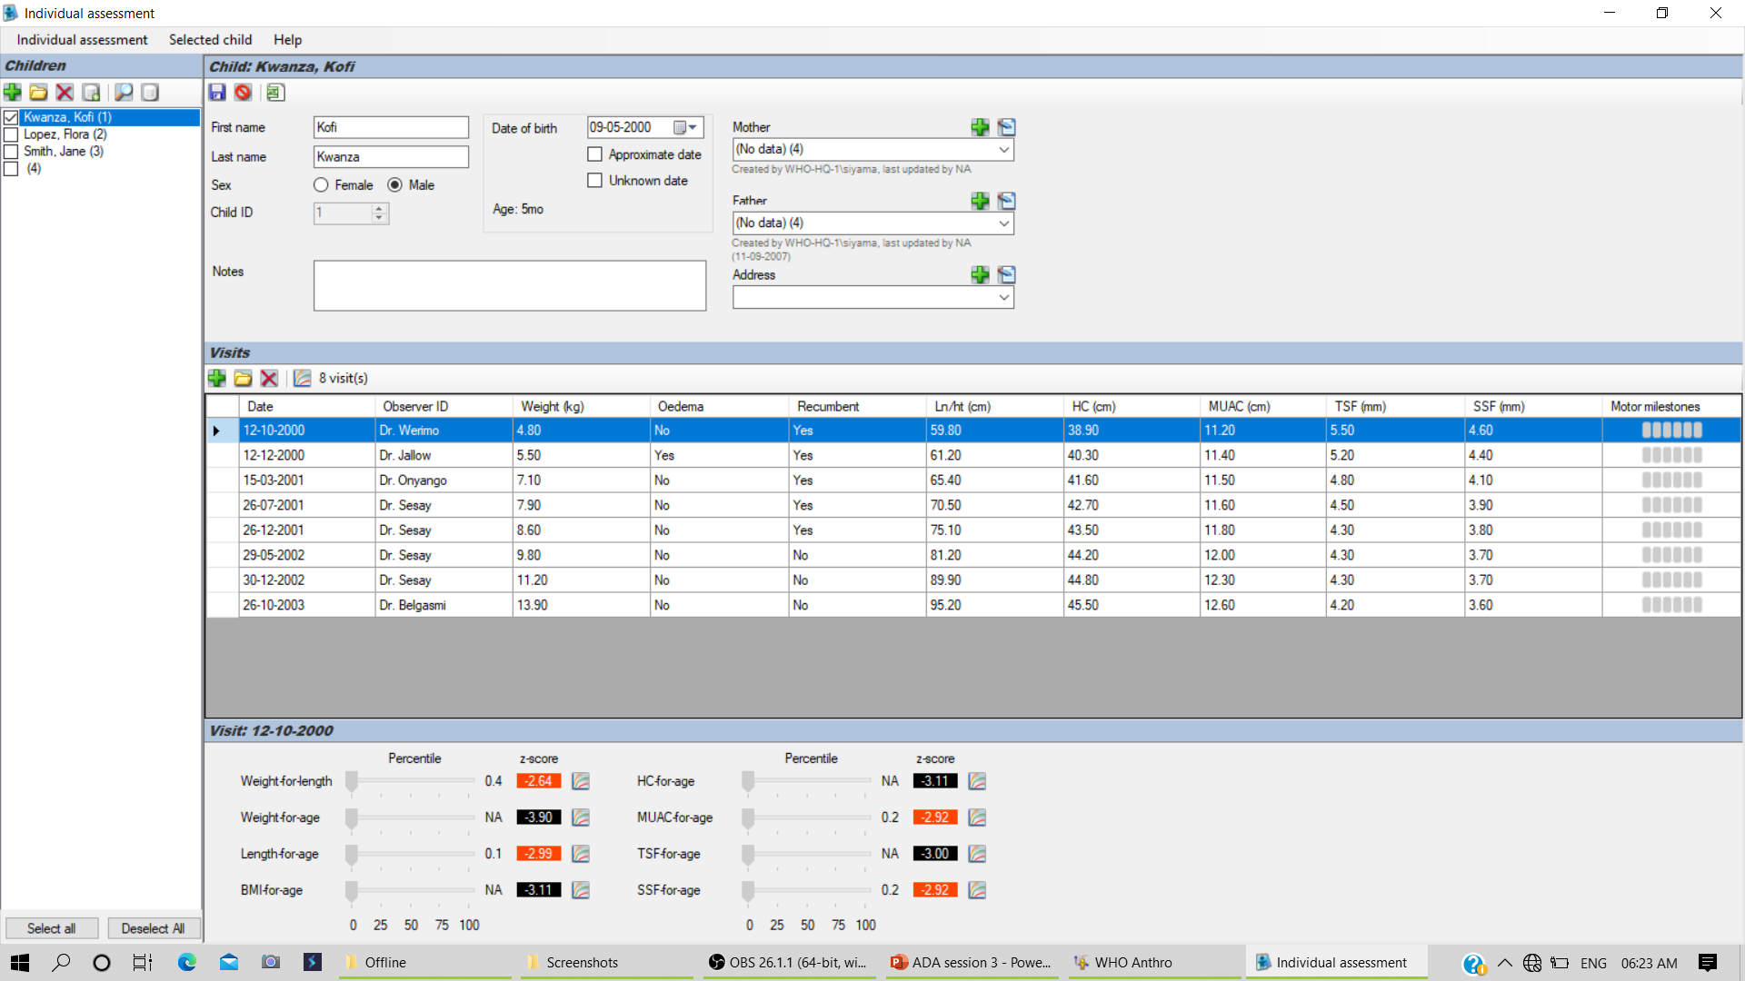
Individual growth chart z score

Slide 38
Generating child report in Anthro individual assessment

Slide 39
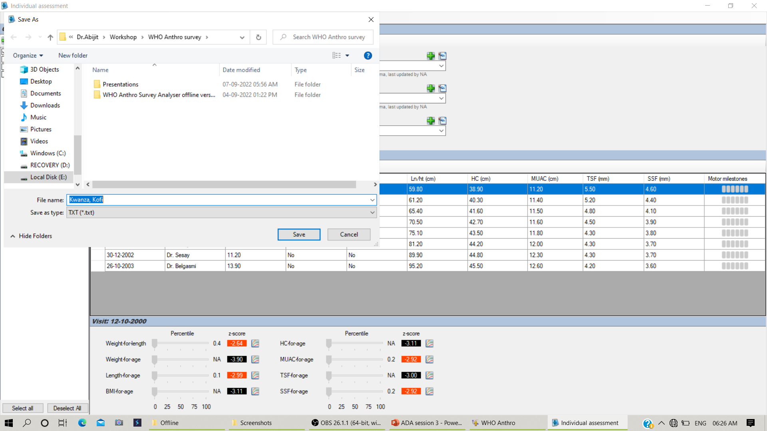
Generating child report

Slide 40
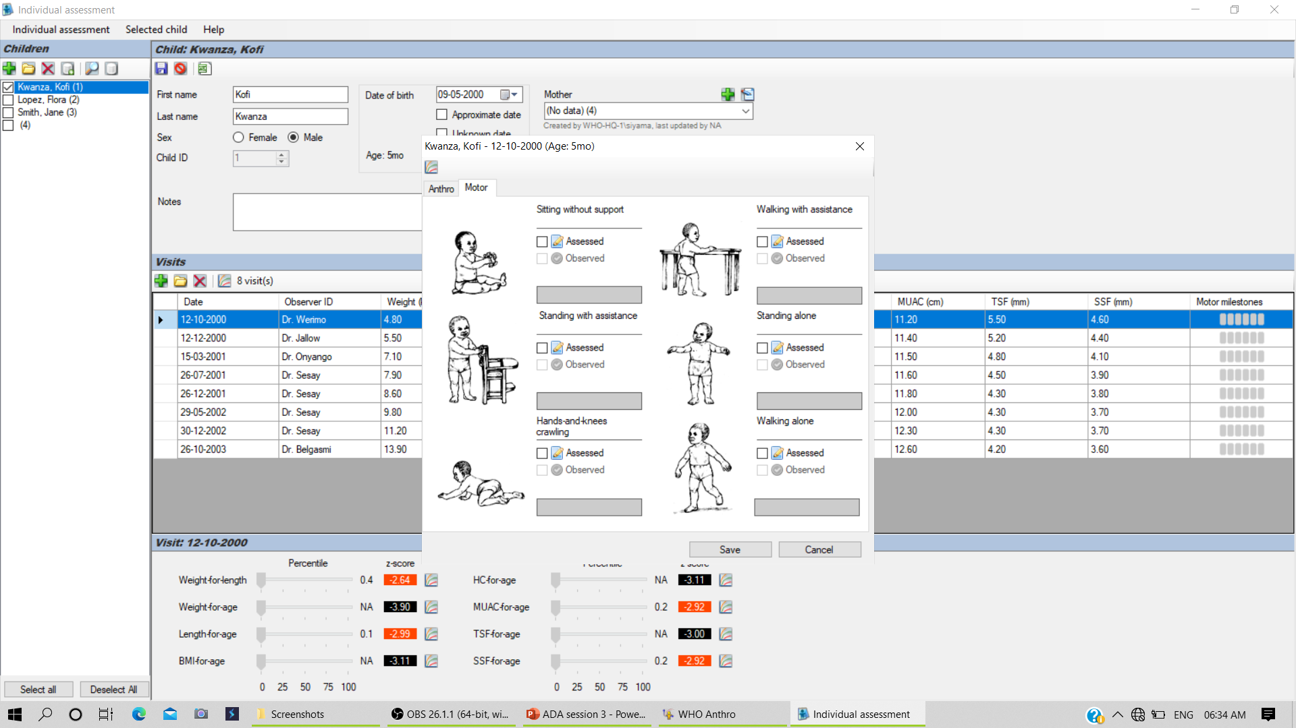
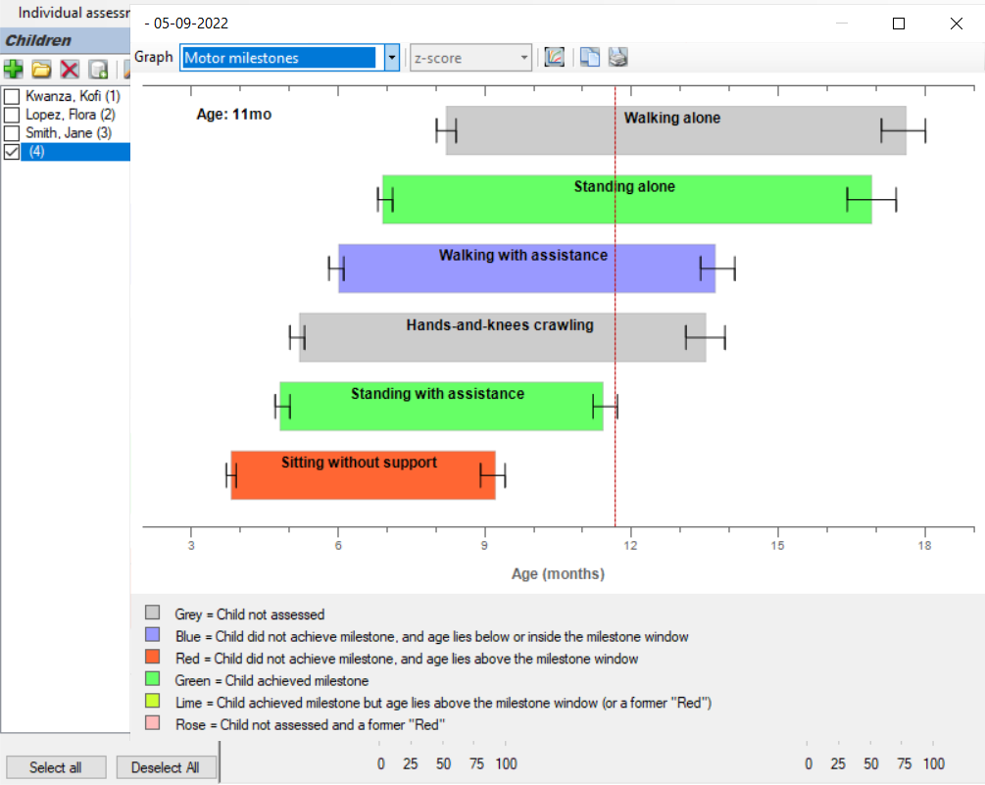

Slide 41
WHO Anthro software
Demonstration with dataset_1
Notes:
Nutritional survey, txt form

Slide 42
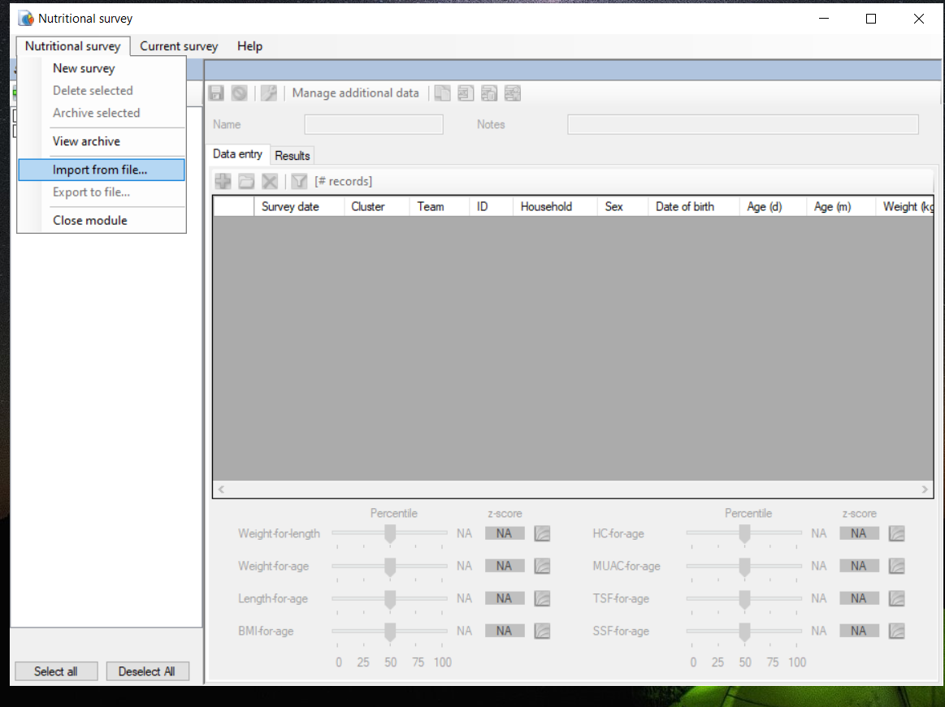
3.Nutritional survey in anthro

Slide 43
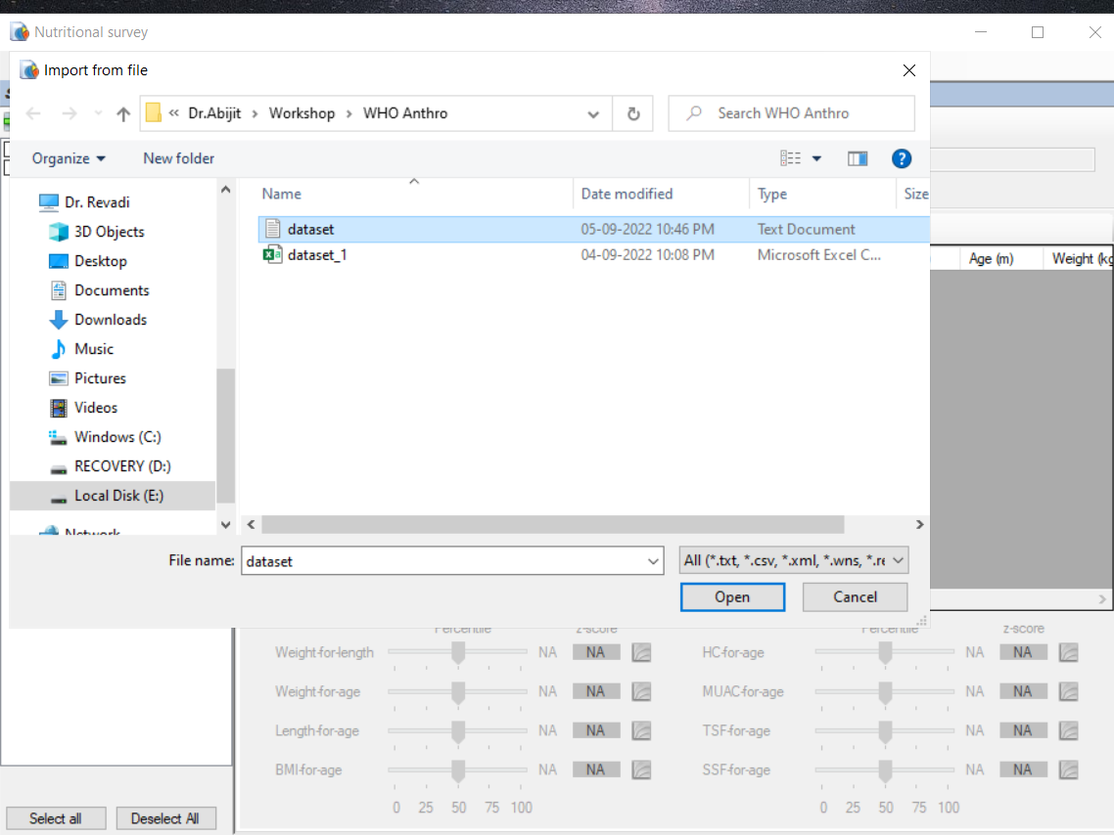
Txt format

Slide 44
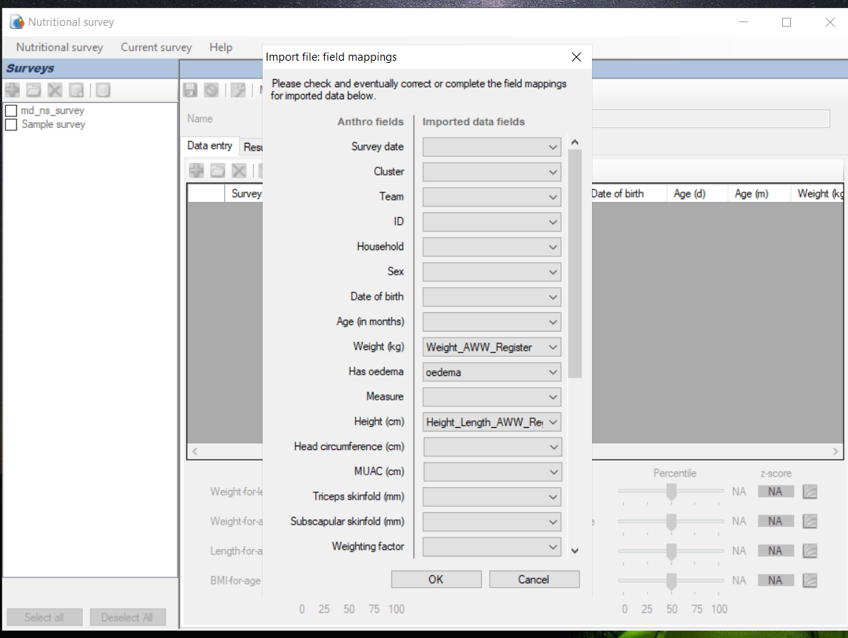
Import file mappings

Slide 45
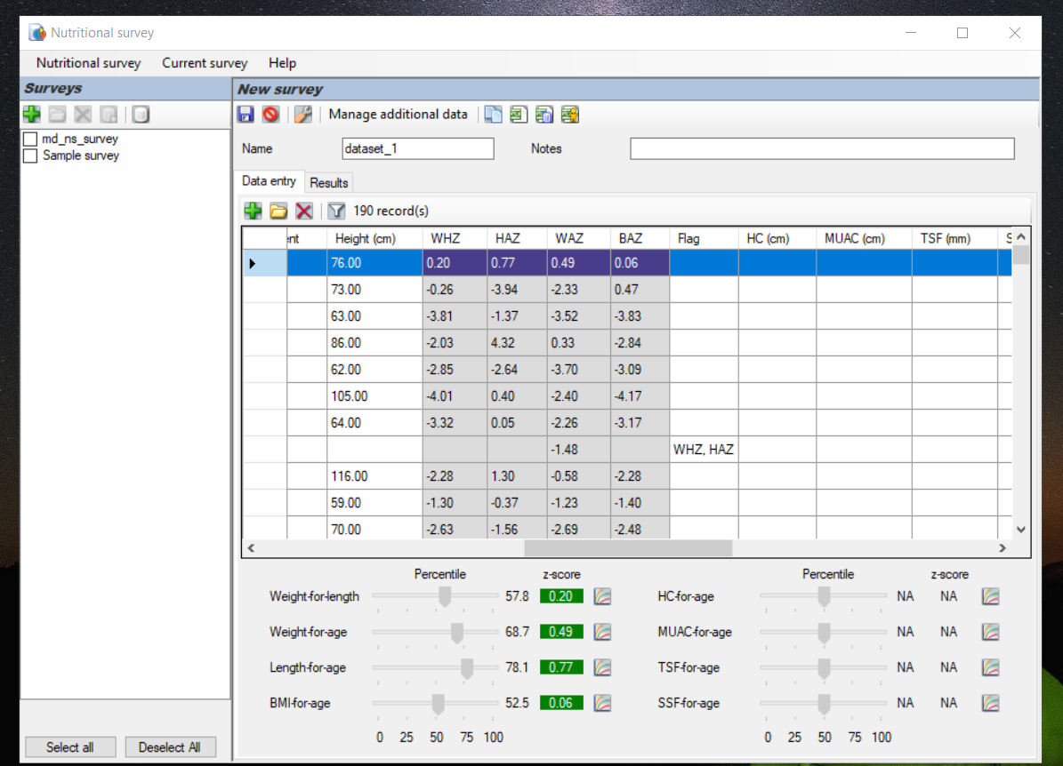
Export output as excel

Slide 46
6. Differences from the Anthro software
Prevalence estimates in Anthro Software include children up to 60.99 months.
Calculation of confidence intervals around prevalence estimates was not updated in Anthro Software
Anthro Survey analyser included a new data validation related to the information on measurement position
Notes:
5 years +/- 9 months

Slide 47
7.Hands on Practice
Using WHO Anthro Survey Analyser in Dataset_2
Z score
Prevalence
Notes:
Nutritional survey, txt form

Slide 48
Thank You
Notes:
Z score, percentile, confidence interval

